Slide 1

www.IRONSHARPENSIRON.net
Worship - Seminars - Exhibitors - Resources
For Men of All Ages. (13 and Up)

Slide 2
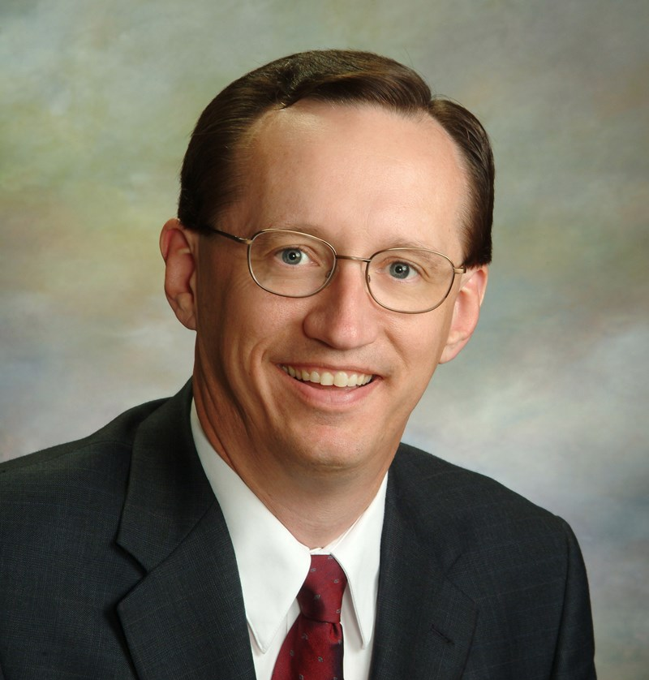
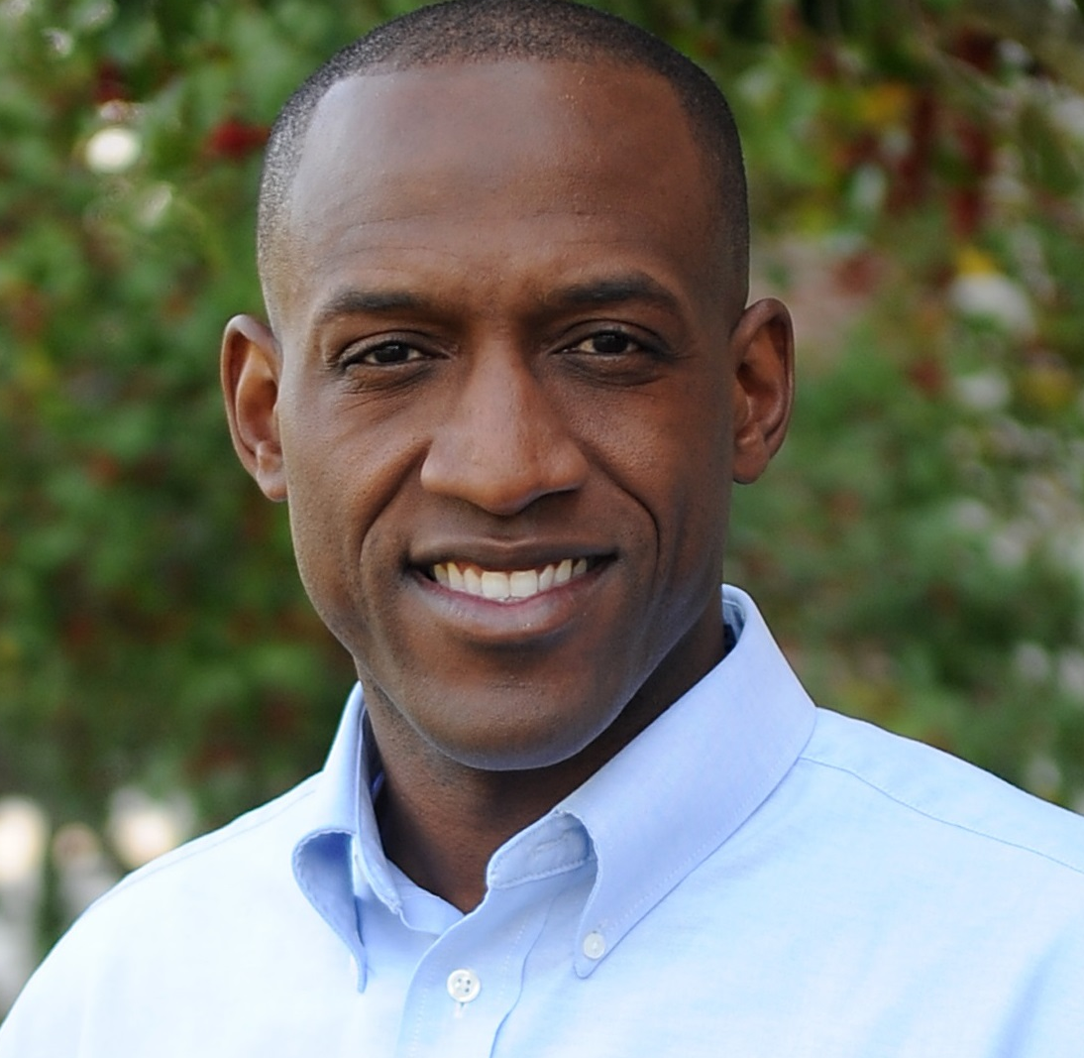
Ken Bevel
Fireproof and Courageous
Jeff Iorg
President Of Gateway Seminary
The First Cathedral
1151 Blue Hills Ave
Bloomfield, CT 06002
March 16th
Register With The Men of This Church.
(Ages 13 and Up)

Slide 3
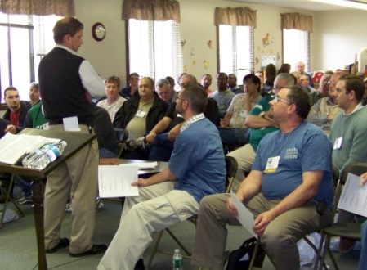
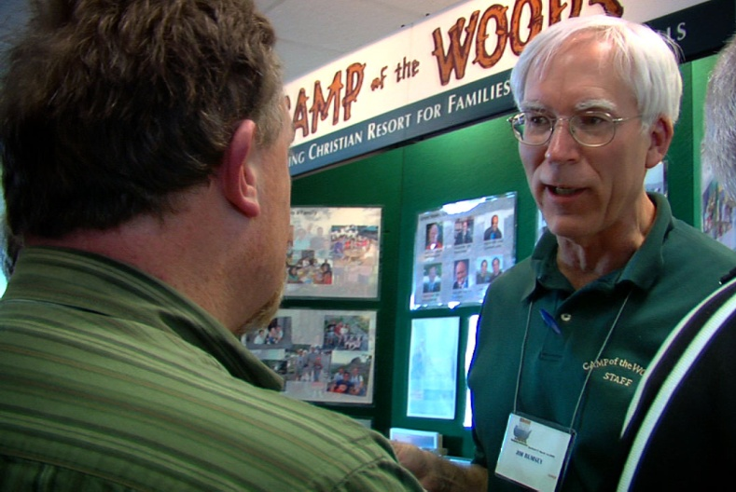
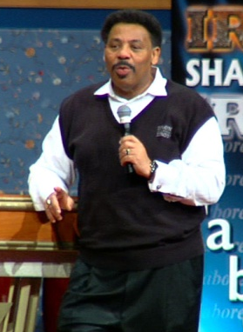
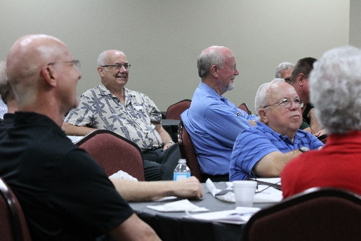
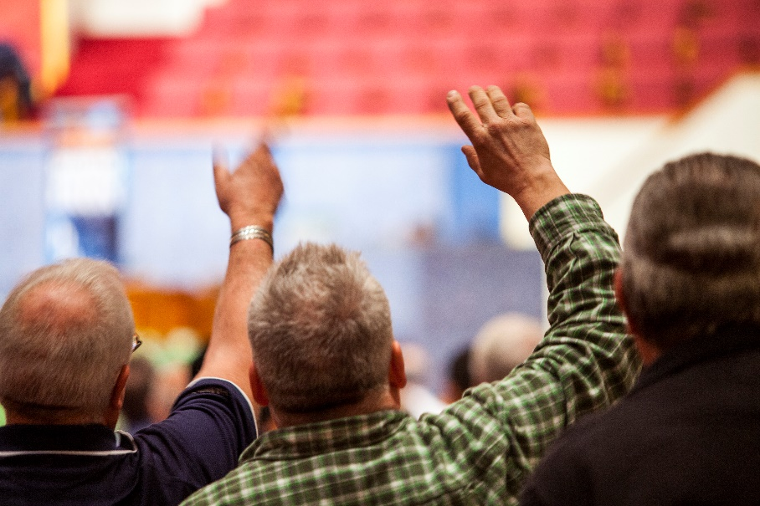
What Happens At Iron Sharpens Iron?
Seminars Specific
To Men
Men’s
Resources
Praise & Worship

Slide 4
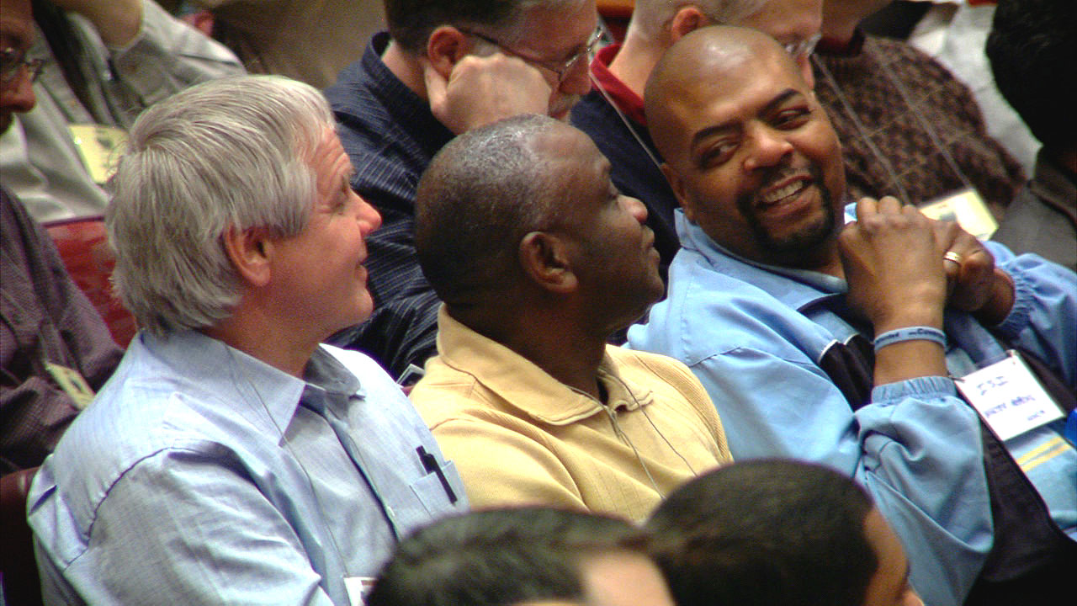
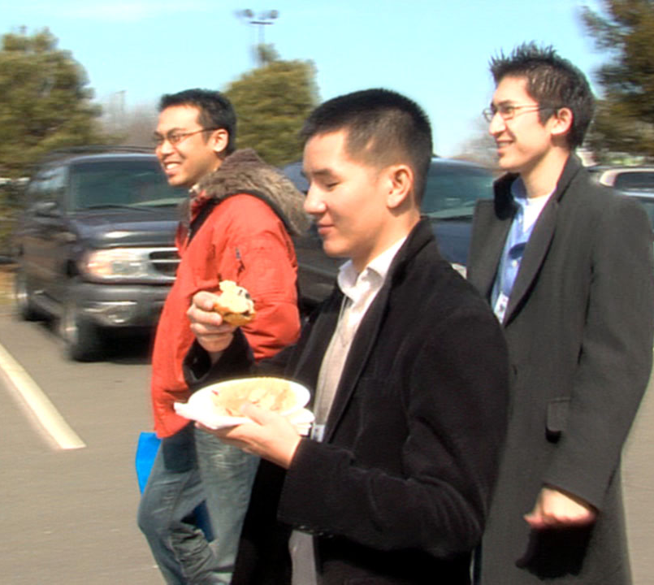
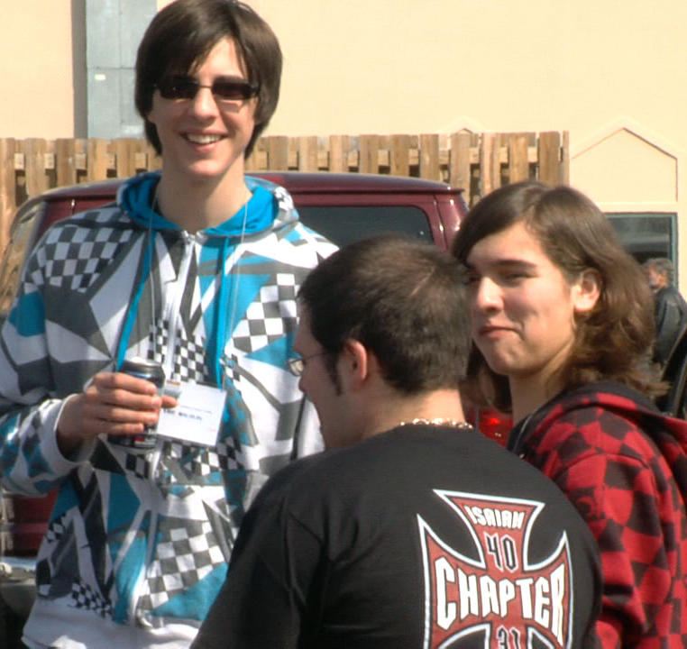
Who Should Attend
Iron Sharpens Iron?
www.IRONSHARPENSIRON.net
Worship - Seminars - Exhibitors - Resources
For Men of All Ages. (13 and Up)

Slide 5
The Specifics
$59 Per Man - $29 Students
Starts on Time and Ends on Time 8:30am – 4:55pm
Seminars Specific To Men
www.IRONSHARPENSIRON.net
Worship - Seminars - Exhibitors - Resources
For Men of All Ages. (13 and Up)

Slide 6
Sign-up Today With
The Men of This Church.
www.IRONSHARPENSIRON.net
Worship - Seminars - Exhibitors - Resources
For Men of All Ages. (13 and Up)

