Slide 1
www.IRONSHARPENSIRON.net
Worship - Seminars - Exhibitors - Resources
For Men of All Ages. (13 and Up)

Slide 2
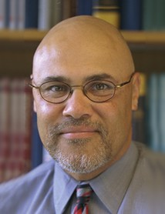
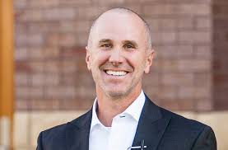
Vince Miller
Resolute
Rod Cooper
Gordon-Conwell Theological
November 3rd
The Gathering Place @ NSBC
420 S Main St
Syracuse, NY 13212
Register With The Men of This Church.
(Ages 13 and Up)

Slide 3
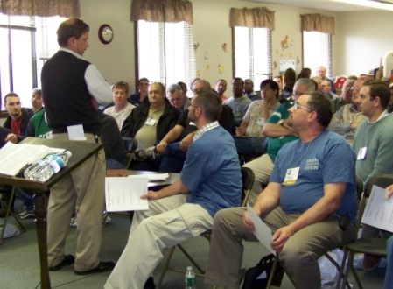
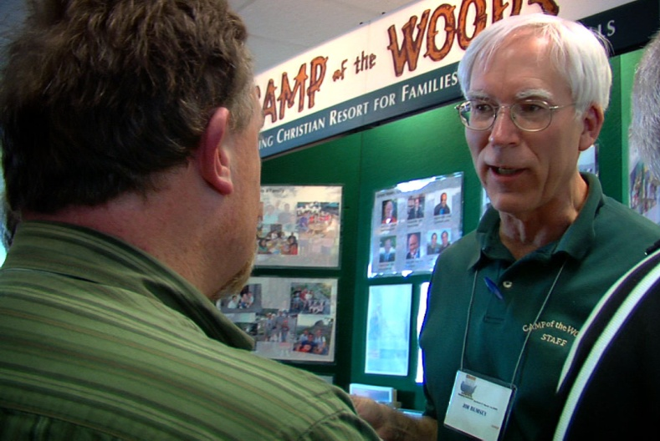
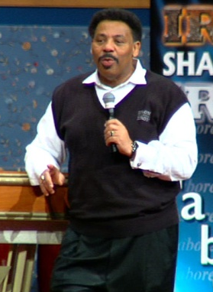
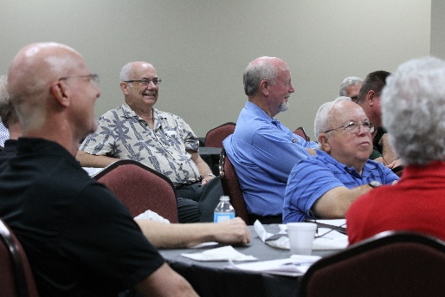
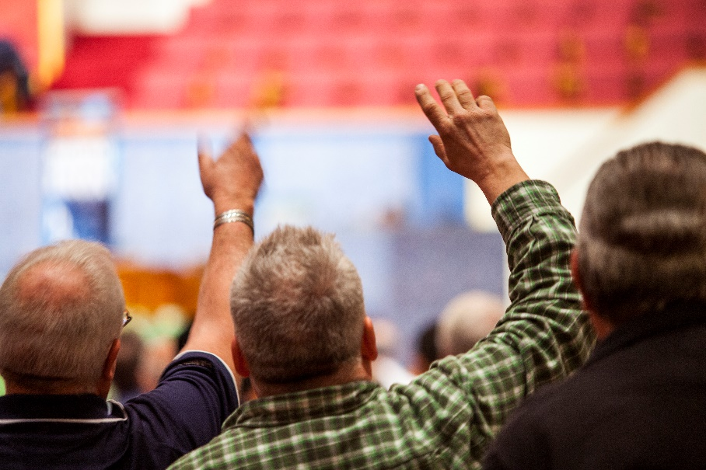
What Happens At Iron Sharpens Iron?
Seminars Specific
To Men
Men’s
Resources
Praise & Worship

Slide 4
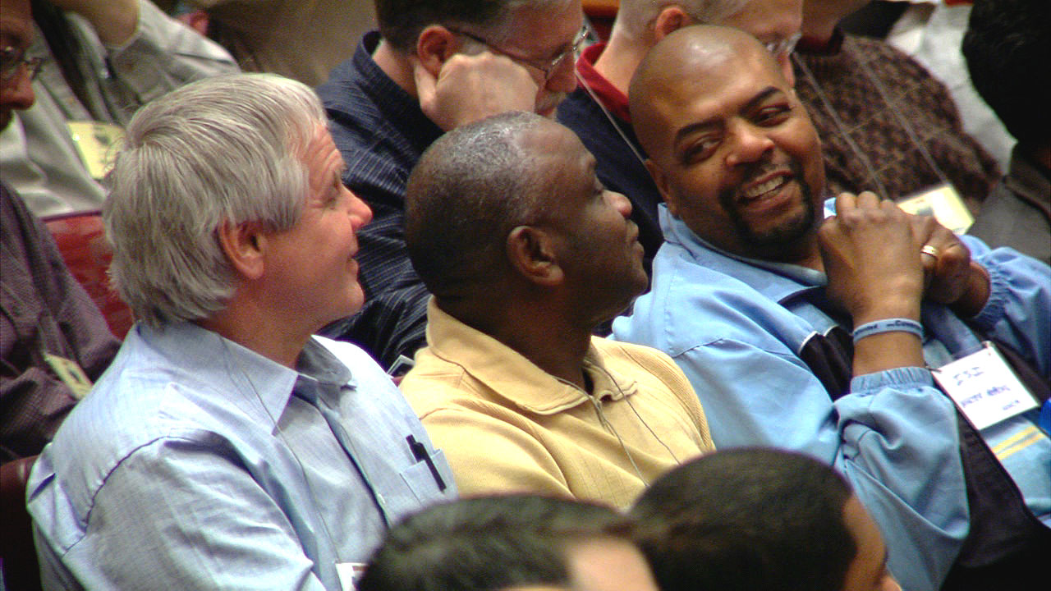
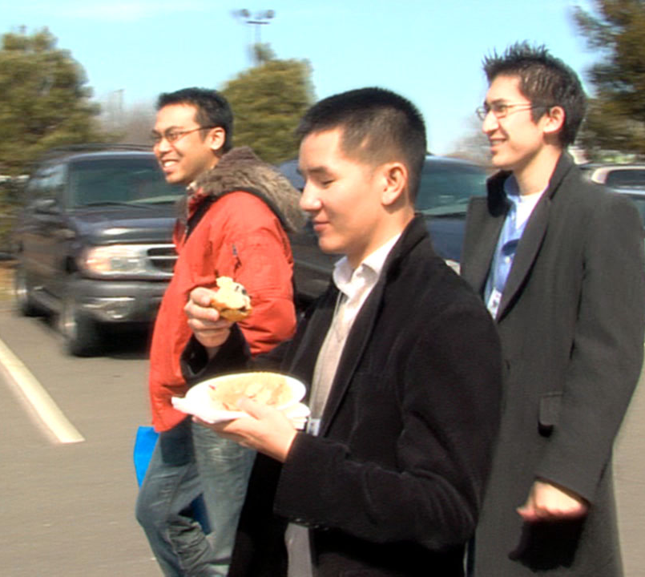
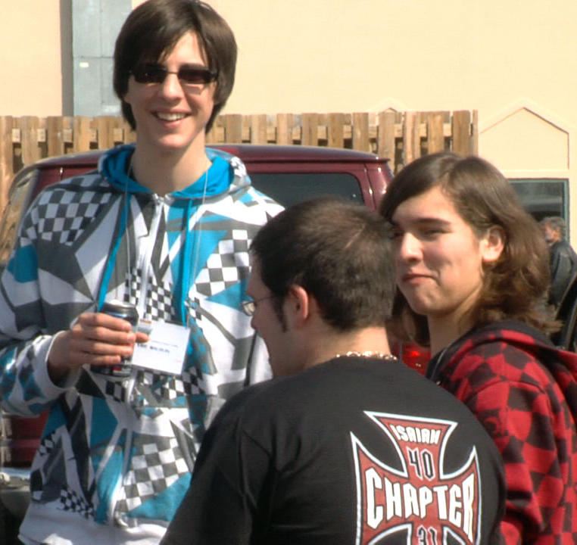
Who Should Attend
Iron Sharpens Iron?
www.IRONSHARPENSIRON.net
Worship - Seminars - Exhibitors - Resources
For Men of All Ages. (13 and Up)

Slide 5
The Specifics
$53 Per Man - $29 Students
Starts on Time and Ends on Time 8:30am – 4:55pm
Seminars Specific To Men
www.IRONSHARPENSIRON.net
Worship - Seminars - Exhibitors - Resources
For Men of All Ages. (13 and Up)

Slide 6
Sign-up Today With
The Men of This Church.
www.IRONSHARPENSIRON.net
Worship - Seminars - Exhibitors - Resources
For Men of All Ages. (13 and Up)

